Slide 1

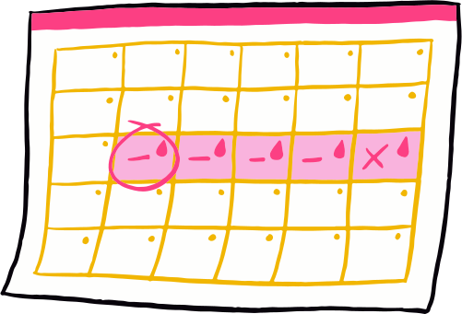

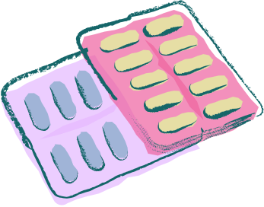

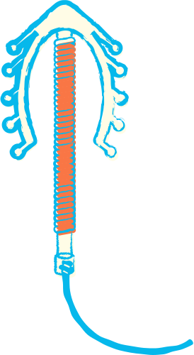

EXPLORING THE FACTORS AFFECTING CONTRACEPTION USE OF ELIGIBLE COUPLES
RI BHOI, MEGHALAYA
Presented by: Lakhi Mondal, Sreya Bhattacharya
The Hans Foundation – MEL Interns

Slide 2

BACKGROUND
Meghalaya has one of India’s highest fertility rates (TFR = 2.91) and lowest contraceptive use (~27%).
Cultural, geographical, and systemic challenges shape reproductive behavior.
Importance of exploring socio-cultural & service-level factors.

Slide 3

OBJECTIVE
Understand knowledge, attitudes & practices (KAP)
of eligible couples regarding contraception.
Explore socio-cultural, infrastructural, and service-level barriers.
Generate evidence-based recommendations for reproductive health interventions.

Slide 4
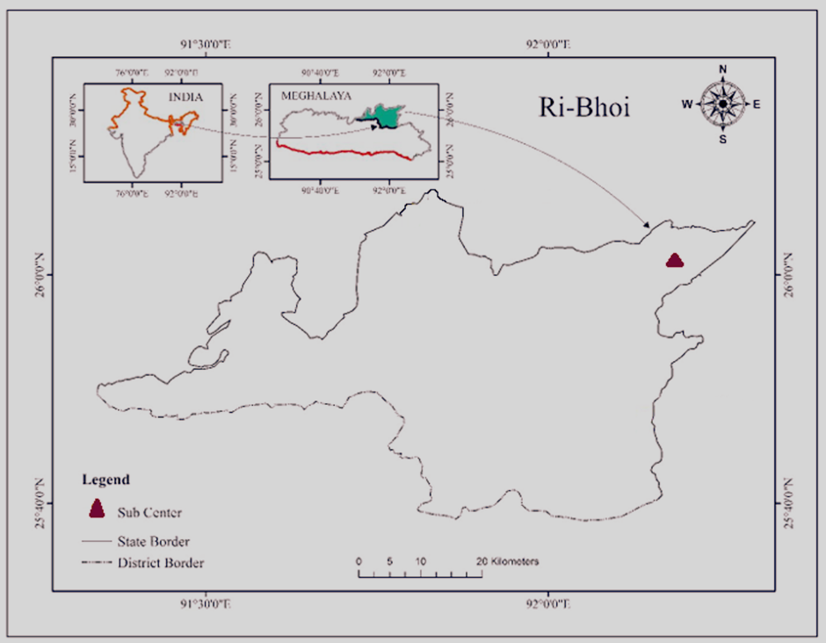
STUDY AREA & TARGET GROUPS
Target Respondents:
Married women (18–49 years)
Married men (18–54 years)
Health workers (ASHAs, ANMs, GNMs, etc.)
The study was conducted in some villages under Amjong Sub-centre, Ri-Bhoi district, Meghalaya, focusing on tribal populations' contraceptive practices.
Study Area

Slide 5

METHODOLOGY
Design: Cross-sectional, quantitative
Tools: 3 structured questionnaires
Sample size: 75 (48 women, 12 men, 15 health workers)
Sampling Technique: Random & purposive sampling

Slide 6


KEY FINDINGS
MALE RESPONDENTS

Slide 7
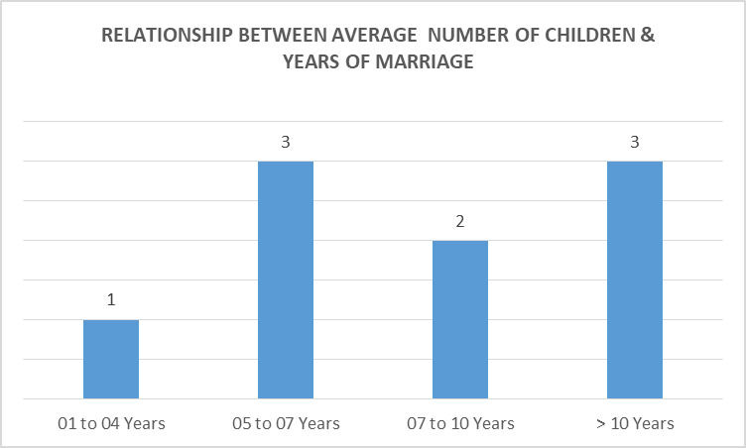
Children increased with marital duration (avg. 3 children after 10+ years)

Slide 8
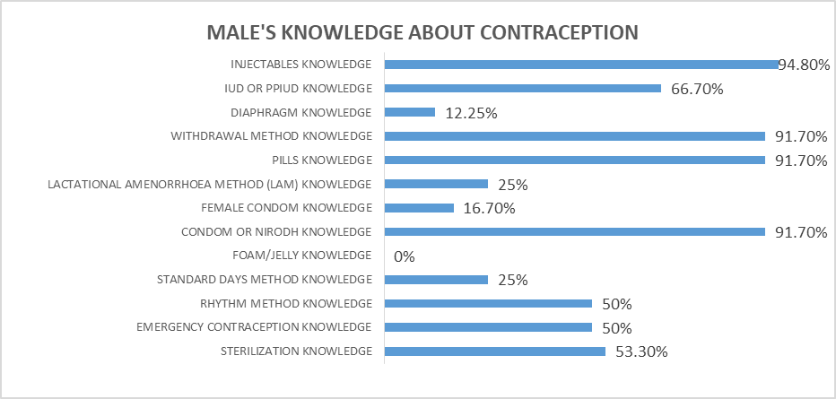
Chart shows highest knowledge of injectables (94.8%) and lowest
for foam/jelly (0%). There is a high awareness of pills, injectables, condoms, withdrawal
but there is a very low awareness of diaphragm and female condom.

Slide 9
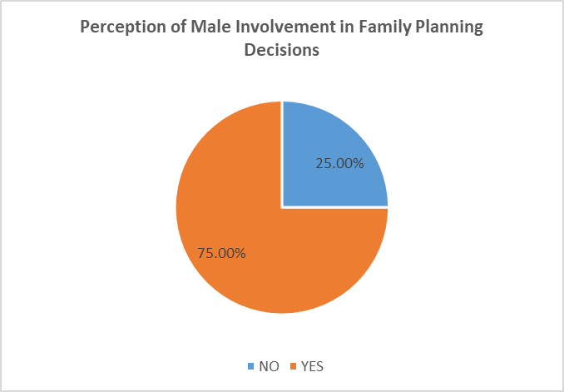
The perception that 75% of men are involved in family planning decisions is encouraging and reflects a positive shift toward shared reproductive responsibilities.

Slide 10

OTHER FINDINGS:
Misconceptions persist; fear of side effects observed
Male respondents shy or hesitant to discuss openly
Need for improved male-targeted IEC and peer education

Slide 11

KEY FINDINGS
FEMALE RESPONDENTS

Slide 12
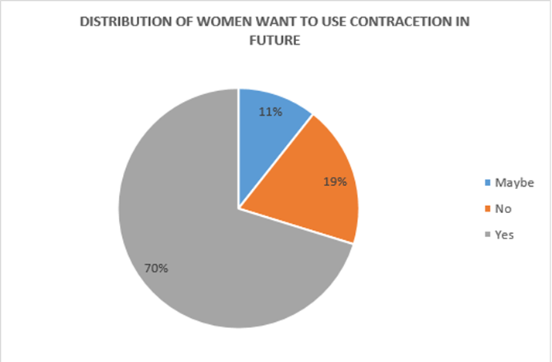
70% of the respondents intend to use contraception in future; 19% say no, 11% unsure

Slide 13
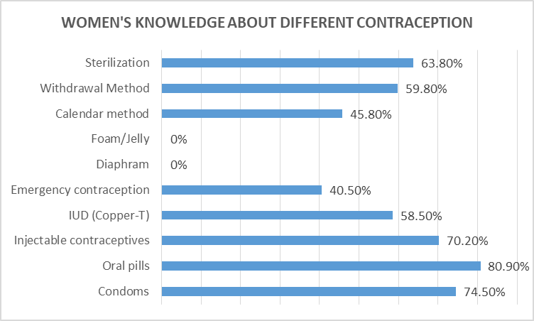
Chart shows highest knowledge of Oral pills (80.9%) and lowest
for foam/jelly & diaphragm (0%).
There is a high awareness of pills, injectables, condoms

Slide 14
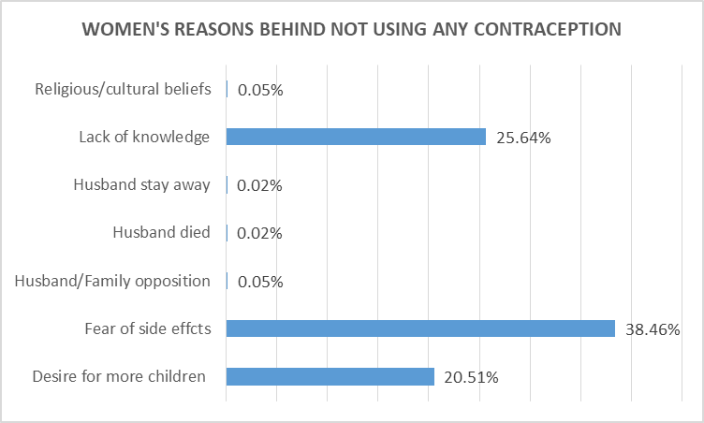
Top barriers to use contraception for women are:
Fear of side effects (38.4%), Lack of knowledge (25.6%) & Desire for more children (20.5%)

Slide 15
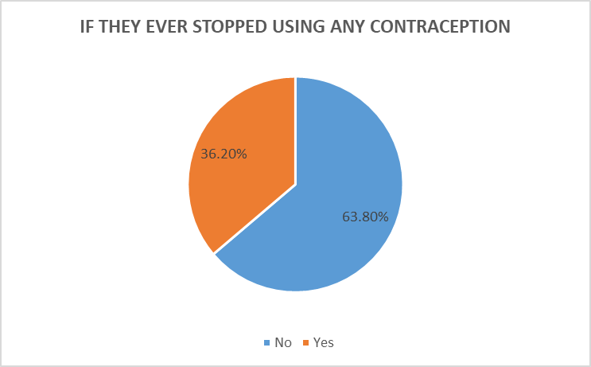
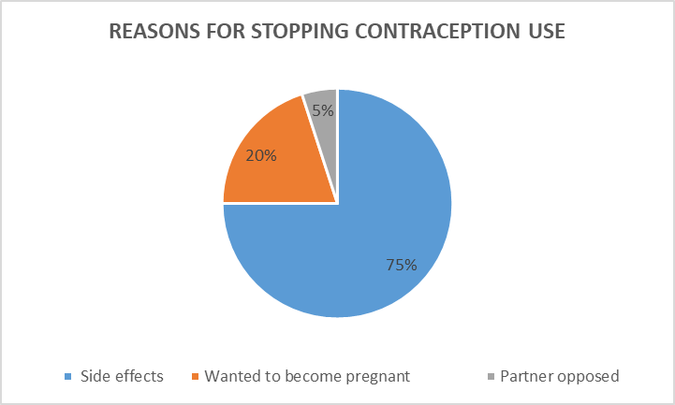
36.2% stopped using contraception. Reasons are as follows →
To get pregnant, due to side effects & due to partner opposition.

Slide 16

OTHER FINDINGS:
Women using contraception lived closer to
health sub-centers and roads.
Distance linked with non-use: limited outreach and mobility.
.
Highlights need for improved last-mile delivery
and sub-center support.

Slide 17


KEY FINDINGS
HEALTH WORKERS

Slide 18
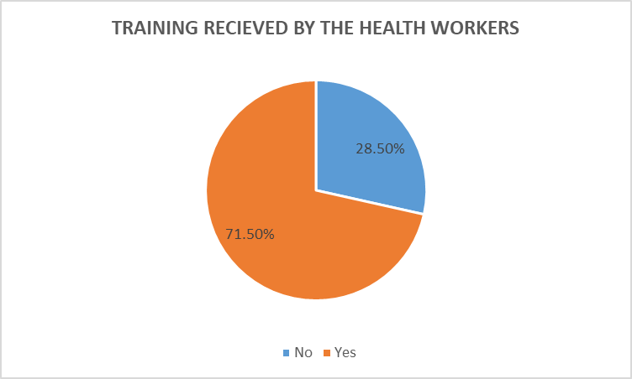
Training on family planning received by most

Slide 19
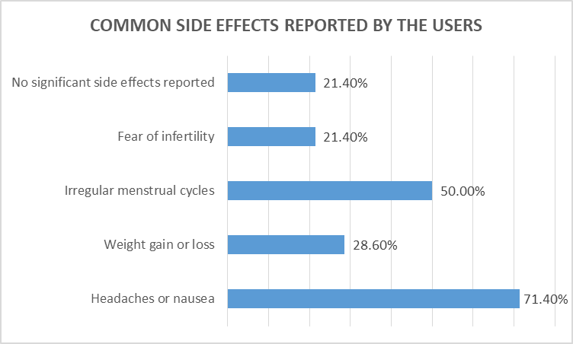
Frequently report side effects as Headaches or nausea,
Irregular menstrual cycles as major complaint from users.

Slide 20
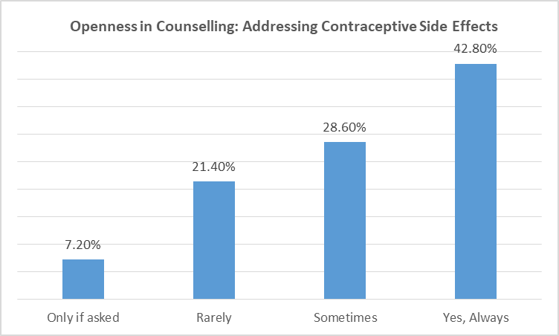
Most of the them address the possible side effects to the users.

Slide 21
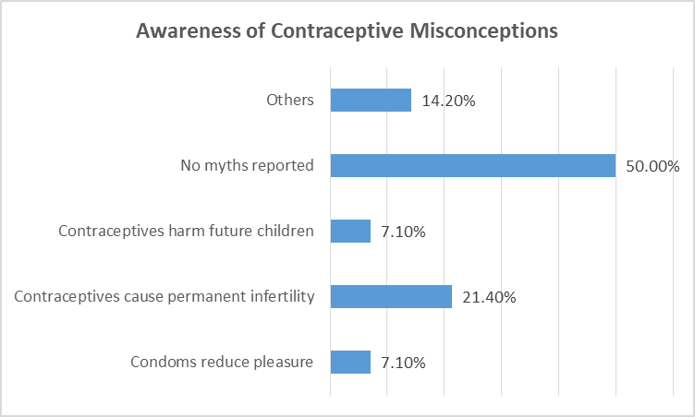
They are aware of misconceptions among respondents
like infertility, harm to uterus, long-term damage

Slide 22

OTHER FINDINGS:
67% involve husbands in counselling sessions
Promoting contraception to newly married couples is still sensitive
Barriers reported:
→ Lack of stock at times
→ Fear among clients
→ Gender norms and silence around contraception
Positive rapport helped mitigate language challenges in survey

Slide 23

KEY BARRIARS IDENTIFIED :
Cultural and religious beliefs
Fear of side effects and misinformation
Male partner opposition and low involvement
Poor accessibility to sub-centres and roads
Limited male-centric counselling and IEC

Slide 24

RECOMMENDATIONS :
Increase male involvement through tailored communication
Strengthen capacity and mobility of ASHAs and ANMs
Promote contraceptive education using tribal language IEC
Ensure regular supply of diverse contraceptive methods
Target newly married couples and high-parity families

Slide 25

LEARNINGS AS INTERNS :
Conducted community-based research in remote tribal villages
Gained hands-on experience in data collection, analysis, and reporting
Overcame challenges: language, terrain, shy respondents
Witnessed real-time barriers in public health delivery

Slide 26



